Slide 1

Netflix Movies and TV Shows Clustering
Unsupervised Learning for Content Grouping and Business Insights
Presented by,
Kavya P P
Notes:
“Good [morning/afternoon], I’m Kavya, and today I’ll be presenting my project titled ‘Netflix Movies and TV Shows Clustering.’ This project uses unsupervised learning techniques to group Netflix content in a meaningful way and extract valuable business insights that can drive personalization, strategy, and user experience improvements.”

Slide 2
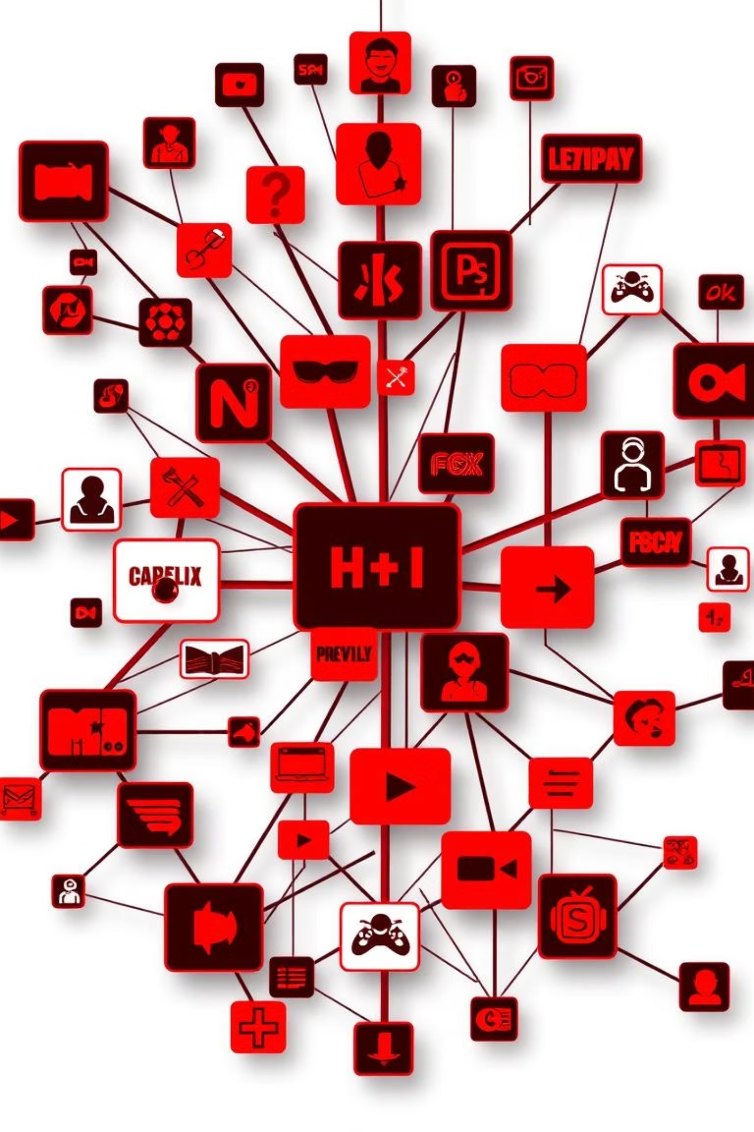
Introduction
Netflix boasts thousands of global titles, making manual categorization and content discovery inefficient. This project applies Unsupervised Machine Learning to uncover patterns, group content, and enable smart recommendations.
Notes:
“Netflix hosts thousands of titles across genres, languages, and countries. Manually organizing this content or identifying trends is inefficient. So, I built a system that uses machine learning to automatically cluster titles based on features like genre, duration, rating, and release year. This not only simplifies discovery but also unlocks insights that can help Netflix serve users better.”

Slide 3

Problem Statement
Content Clustering
How can we automatically cluster Netflix content based on features like genre, type, rating, and duration?
Business Value
Can we extract business value by analyzing these content clusters?
Interactive Dashboard
Can we build an interactive dashboard to explore these patterns and insights?
Notes:
“Our key goals were: First, to automatically cluster Netflix content based on various features. Second, to understand if we can derive business value from these clusters — for example, through recommendations or market trends. And finally, to create an interactive dashboard where stakeholders can explore the clusters and insights on their own.”

Slide 4
Project Objectives
Data Preparation
Clean and preprocess the Netflix dataset.
Clustering Models
Perform clustering using KMeans, DBSCAN, and Hierarchical methods.
Dimension Reduction
Reduce dimensions using PCA for better visualization.
Visualization & Dashboard
Visualize clusters and build an interactive dashboard for insights.
Strategic Recommendations
Recommend strategies for personalization and content curation.
Notes:
“This slide outlines the core objectives of my project:
First, to clean and prepare the dataset.
Second, to test multiple clustering models: KMeans, DBSCAN, and Hierarchical.
Third, to reduce dimensions using PCA for better visualization.
Fourth, to visualize the clustering results clearly.
And lastly, to build a business-focused dashboard that supports recommendations and content strategies.”

Slide 5
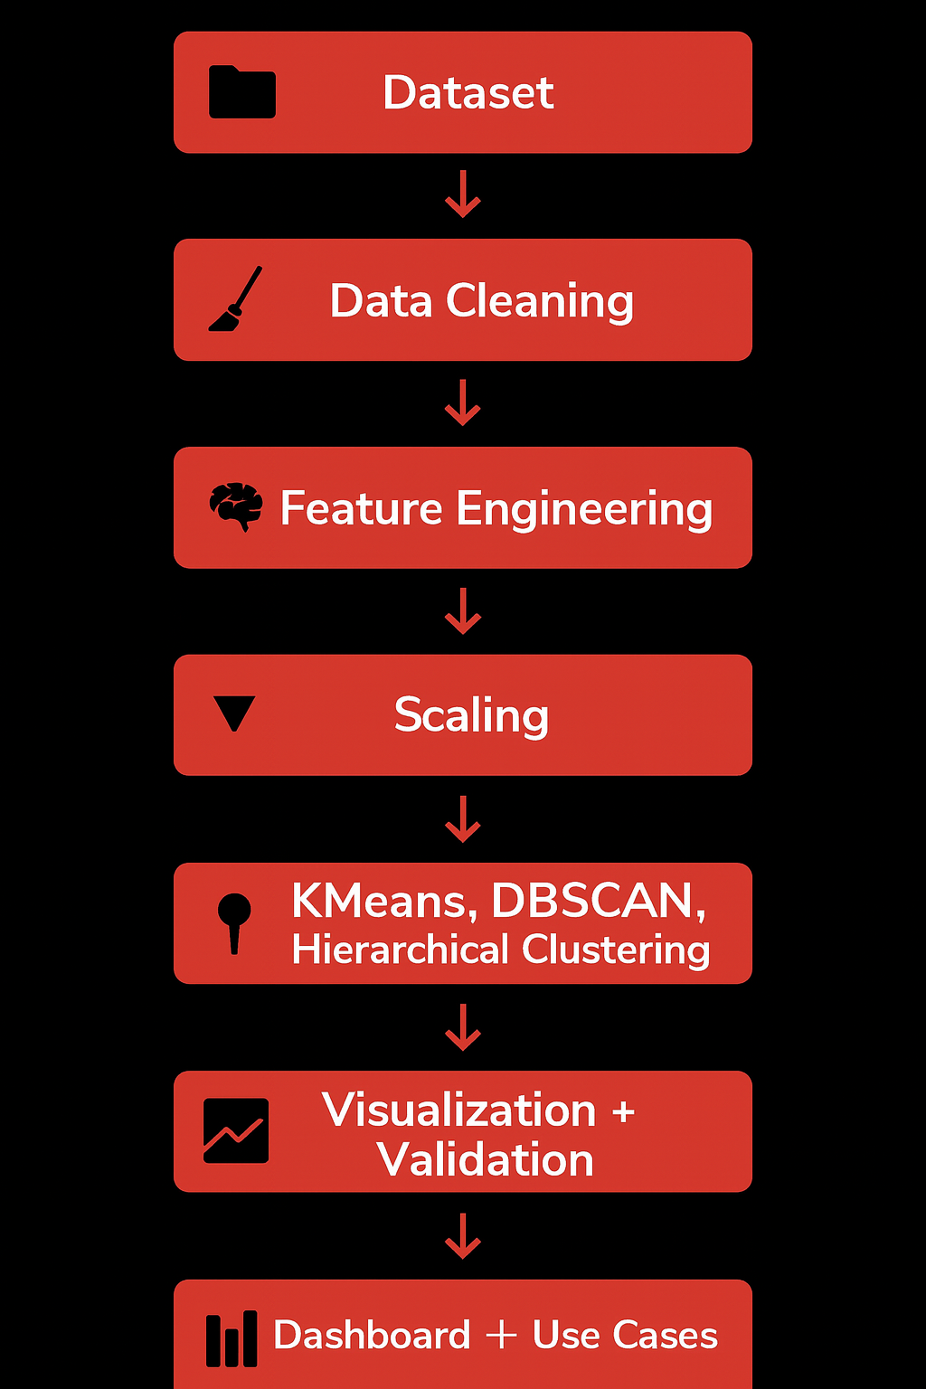
Project Workflow
Dataset: Loaded Netflix Movies & TV Shows data for clustering
Data Cleaning: Removed missing values and duplicates
Feature Engineering: Derived duration, content age, and genre count
Scaling: Applied StandardScaler for normalization
PCA (2D): Reduced dimensions for visual clustering
Clustering: Tested KMeans, DBSCAN, Hierarchical (KMeans chosen)
Visualization + Validation: Used Silhouette & Davies-Bouldin Index
Dashboard + Use Cases: Built interactive visual insights dashboard
Notes:
“Here’s the complete workflow of the project:
We started by loading the dataset and cleaning it.
Then we engineered features like content age and genre count.
The data was scaled and passed through PCA to reduce dimensions.
We applied three clustering models — KMeans performed the best.
Finally, we validated our clusters and built a dashboard to present insights from four specific business use cases.”

Slide 6
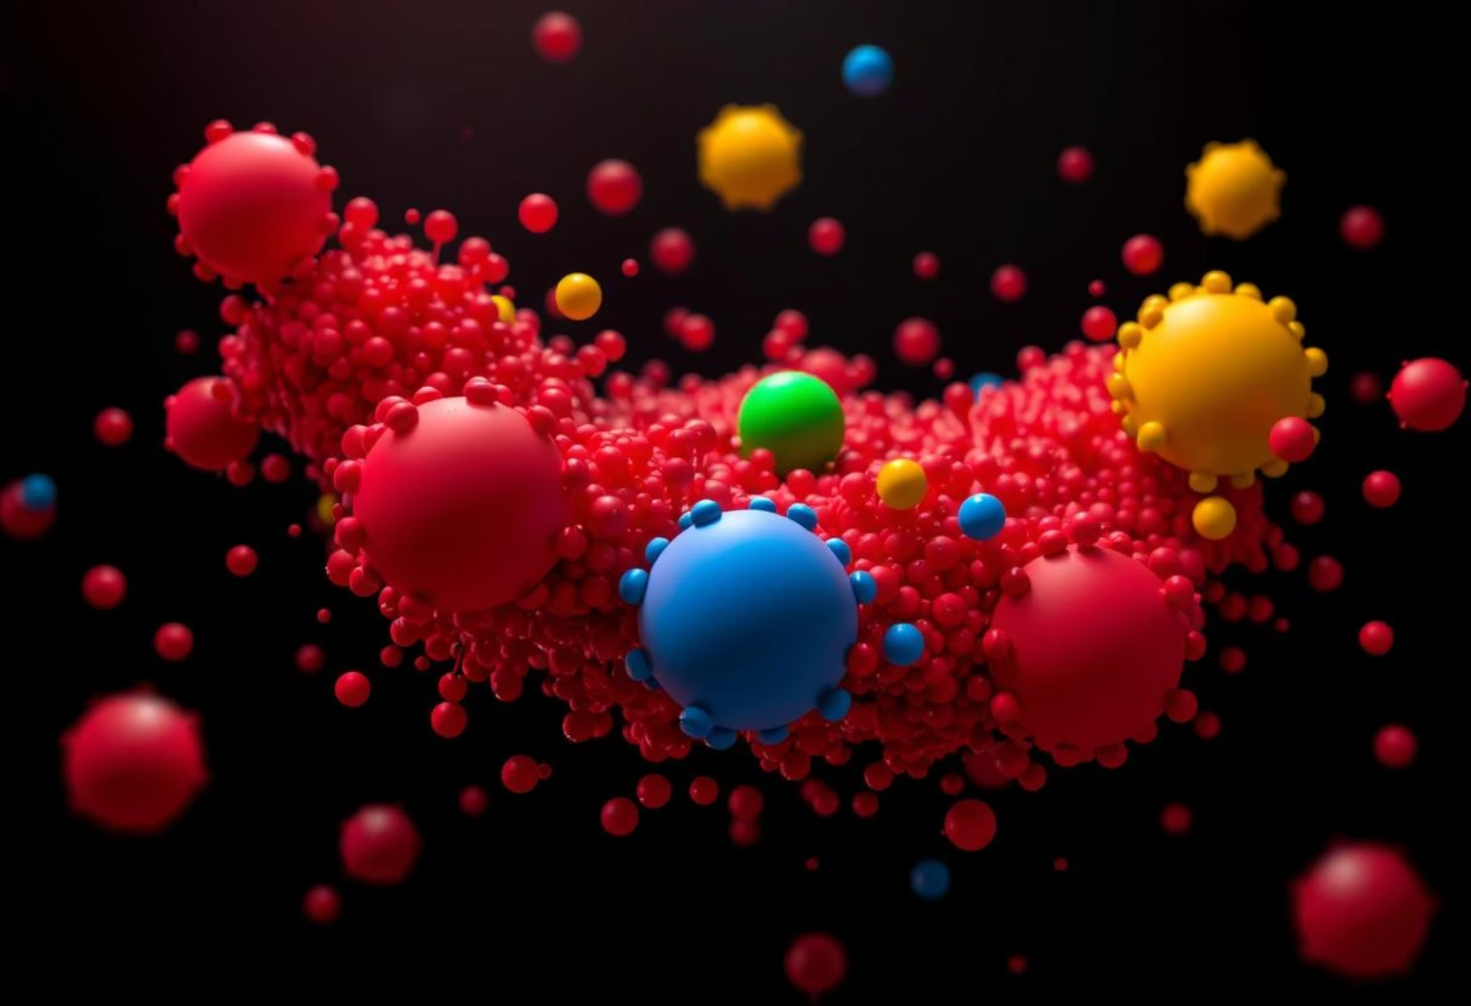
Modeling Techniques
We used and compared three clustering models:
KMeans Clustering: Best performance with balanced, interpretable clusters.
Hierarchical Clustering: Visual via dendrogram but less clear clusters.
DBSCAN: Good for noise detection but underperformed on our dataset.
✔ Final Model: KMeans + PCA
✔ Validation: Silhouette Score and Davies-Bouldin Index
Notes:
“For clustering, I experimented with:
KMeans, which gave well-separated, interpretable clusters.
Hierarchical Clustering, which was good visually but harder to interpret in groups.
And DBSCAN, which is great for noise detection but didn't suit this dataset well. In the end, KMeans with PCA was the most effective combination, and we validated it using the Silhouette Score and Davies-Bouldin Index.”

Slide 7





Data Preparation
Data Cleaning
Removed duplicates and handled missing data points.
Feature Engineering
Created new features: duration in minutes, content age, and genre count.
Encoding
Applied Label and One-Hot Encoding for categorical data.
Scaling & PCA
Scaled data using StandardScaler and applied PCA to reduce dimensions to 2D for clustering
and visualization.
Notes:
“The data preparation included:
Removing nulls and duplicates,
Creating new features like duration in minutes and content age,
Encoding categorical data using Label and One-Hot Encoding,
And finally, scaling the data and applying PCA to reduce it to two dimensions for clustering and visual exploration.”

Slide 8
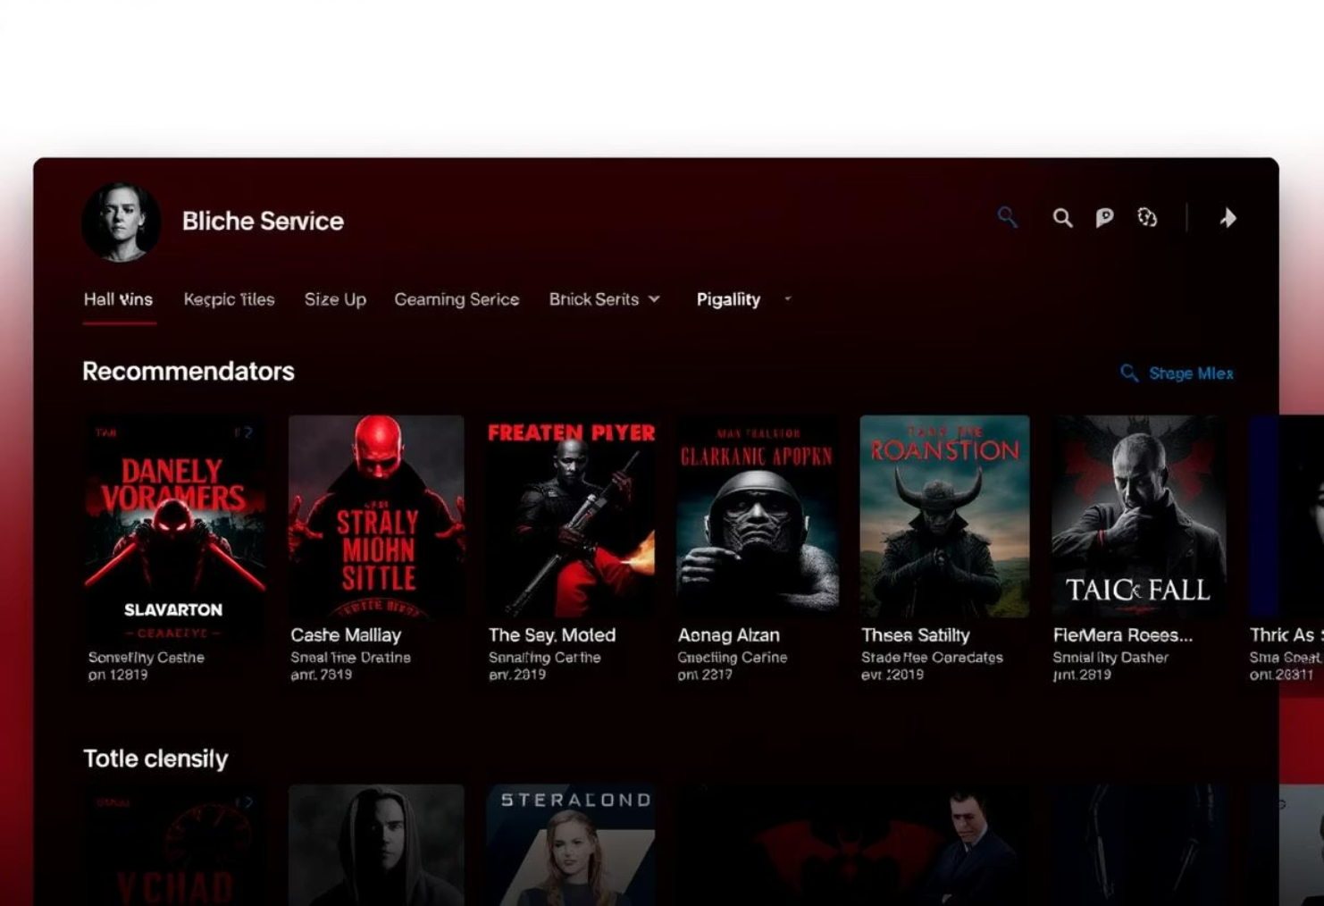
Use Case 1: Personalized Content Recommendation
Goal: Recommend similar shows/movies using clusters.
Each title is assigned to a specific cluster group. We can then recommend content from the same cluster, ideal for personalizing homepage suggestions for users.
Visualization: Select Title → Show cluster neighbors
Notes:
“This use case focuses on using clusters to recommend similar content. Every title was assigned to a specific cluster, so when a user watches something, we can recommend other titles from that same cluster. This creates a smart, cluster-based content recommendation engine that can personalize user experiences.”

Slide 9
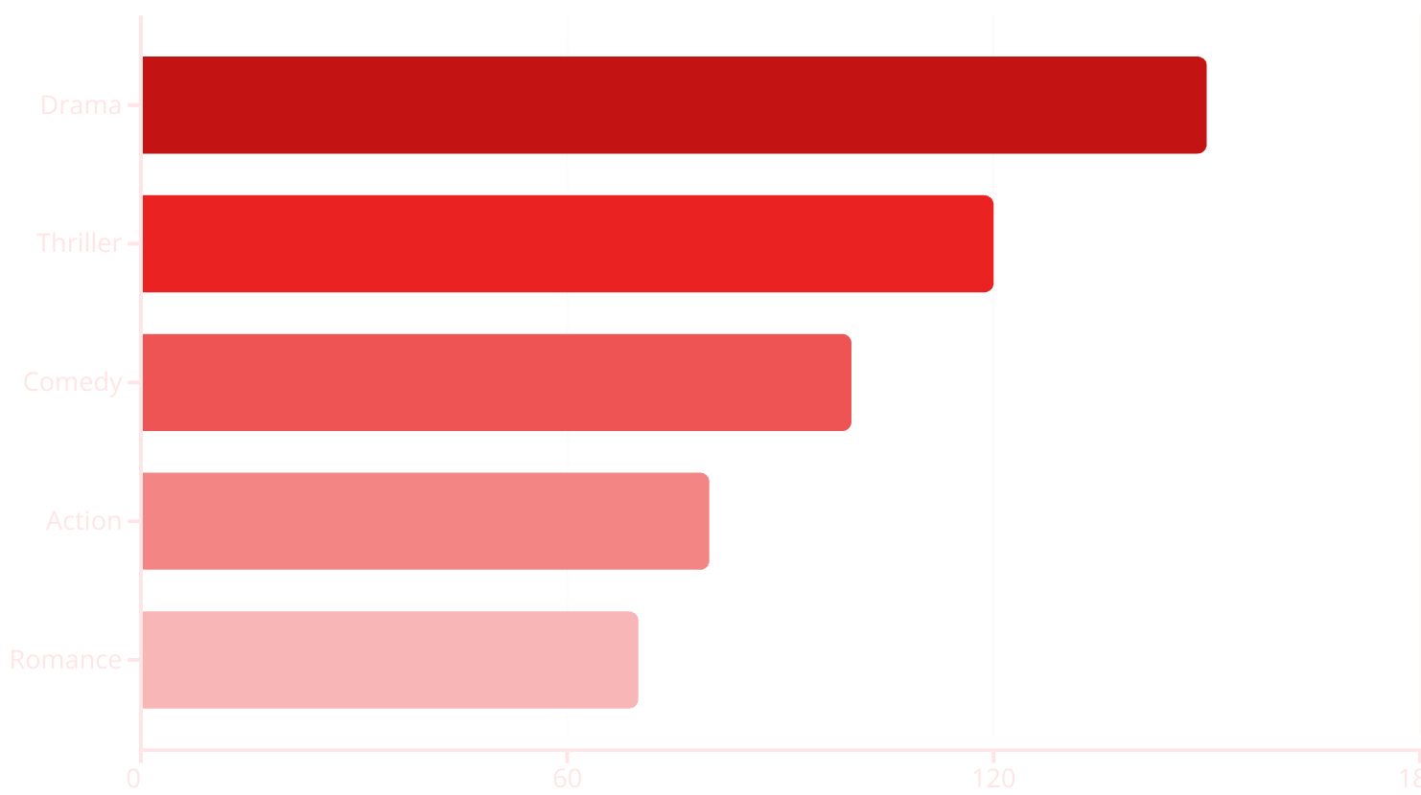
Use Case 2: Top Genres per Cluster
Goal: Understand genre dominance within each cluster.
By analyzing genre counts inside each cluster, we identified distinct groups such as "Family-Friendly Drama," "Global Crime Thrillers," and "Teen Romance Shows."
Visualization: Cluster vs Genre bar chart
Notes:
“In this analysis, I examined the dominant genres in each cluster. Some clusters had heavy drama or romance content, others leaned toward thrillers or international releases. This can help Netflix understand the genre makeup of its catalog and better promote or license content accordingly.”

Slide 10
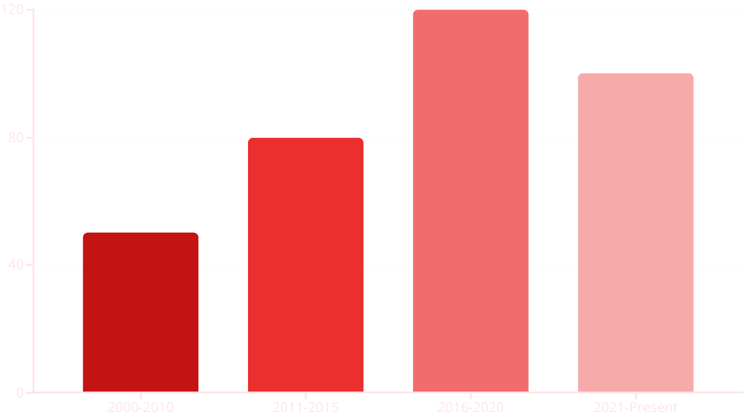
Use Case 3: Content Age Distribution
Goal: Examine the age of content within each cluster.
Analyzing the year of release by cluster revealed groups with older classic titles versus new releases. This is useful for content archival and licensing strategies.
Visualization: Histogram or violin plot per cluster
Notes:
“This use case explores the age of content across clusters. Some clusters had more recent releases, while others had older, classic titles. This information can be useful for archiving strategies or deciding where to push new content vs. evergreen content.”

Slide 11
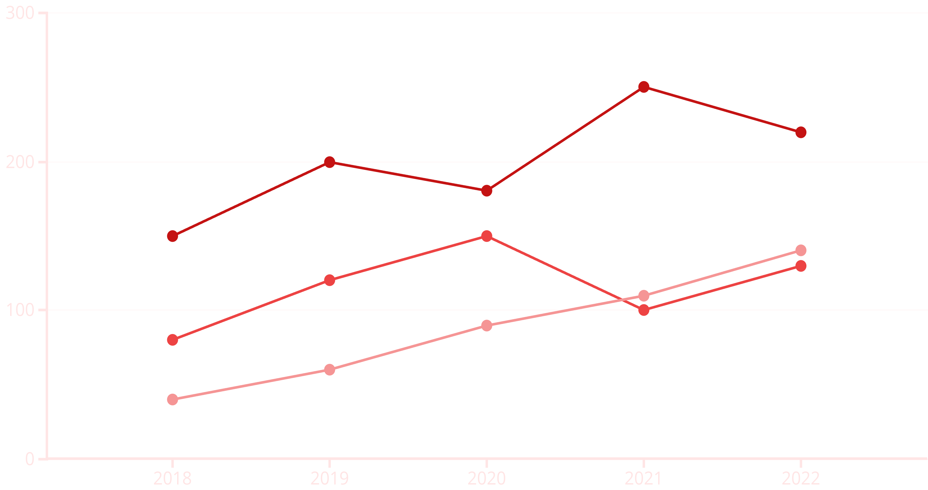
📅 Use Case 4 — Year-wise Content Trend
Our goal was to track content release trends per cluster. The analysis revealed peak periods of content release within each cluster, which helps us understand overall production trends and shifts in platform focus over time.
Cluster 1 Count
Cluster 2 Count
Cluster 3 Count
Notes:
“Here, I looked at how content releases vary by cluster across years. It helped identify trends like which clusters peaked in popularity in certain years. This insight can help platforms like Netflix plan future content acquisition and track how content preferences shift over time.”

Slide 12

✅ Conclusion & Recommendations
KMeans + PCA provided the best clustering clarity, and our dashboard enables interactive insight exploration.
Key Recommendations
Future Work
Integrate clustering into content recommendation engines.
Explore t-SNE for dimensionality reduction.
Use genre and year trends for regional strategy.
Apply NLP on content descriptions.
Extend clustering to include watch behavior & user ratings.
Map user behavior to content clusters.
Notes:
“To conclude:
KMeans + PCA provided the best clustering performance.
We built a working dashboard that allows users to explore insights interactively.
From this, I recommend integrating cluster-driven logic into Netflix’s recommendation engine, using genre trends for regional strategies, and potentially extending this work to include viewer behavior and NLP on content descriptions. Thank you — I’m happy to take any questions.”

